Slide 1

Github Data Exposure and Accessing Blocked Data using GraphQL Security Design Flaw
Research by Shahriar Yazdipour
CCSE CONFERENCE 2020
Technische Universität Ilmenau
Feb 2020

Slide 2
Agenda
Background story
What is graphql
Research process
Conclusion

Slide 3

Restrictions in Iran
GOV loves to make everything difficult
US also loves to make things harder

Slide 4
Blocked By Iran government
Facebook
YouTube
Twitter
Reddit
Telegram
Viber
Tumblr
Spotify
SoundCloud
Netflix
Flickr
WordPress
BBC
Voice of America
Al-Arabiya
Fox News
CBS News
Haaretz
Times of India
The Daily Mail
…
More than 300 site of Top 500
https://gist.github.com/alibo/dfd7c258bcc44a0e8c9f7c5bfd3bd2c3

Slide 5
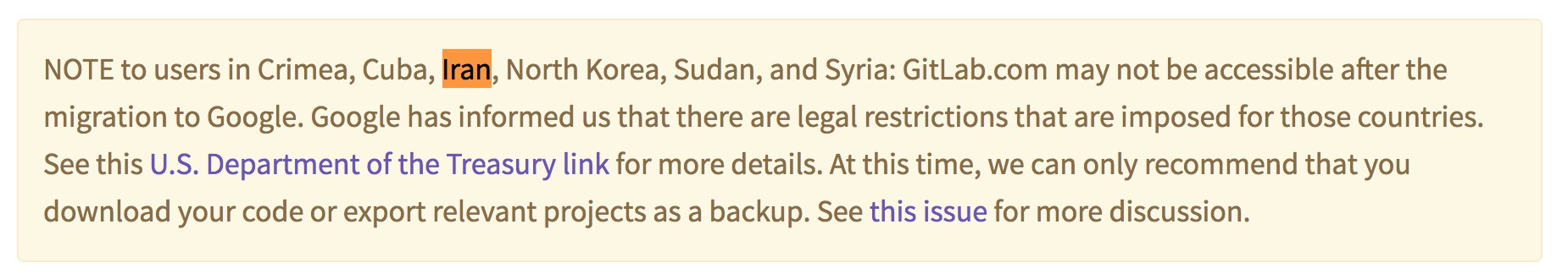
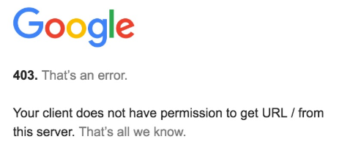
Blocked By Companies
Github
Gitlab
Google Cloud (KhanAcademy,…)
Google/Android Developers
Redhat Repositry
DockerHub
MySQL
Unreal Engine
Intel Download Center
Udemy/Pluralsight
eBay
TeamViewer
MongoDB
Upwork
Avast
GNU Repositories
…
https://gist.github.com/alibo/dfd7c258bcc44a0e8c9f7c5bfd3bd2c3

Slide 6
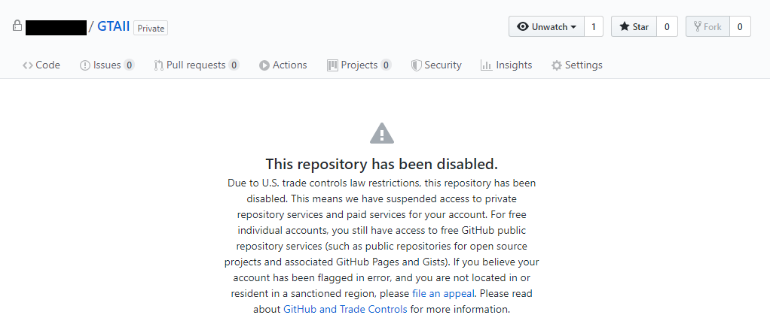

Slide 7
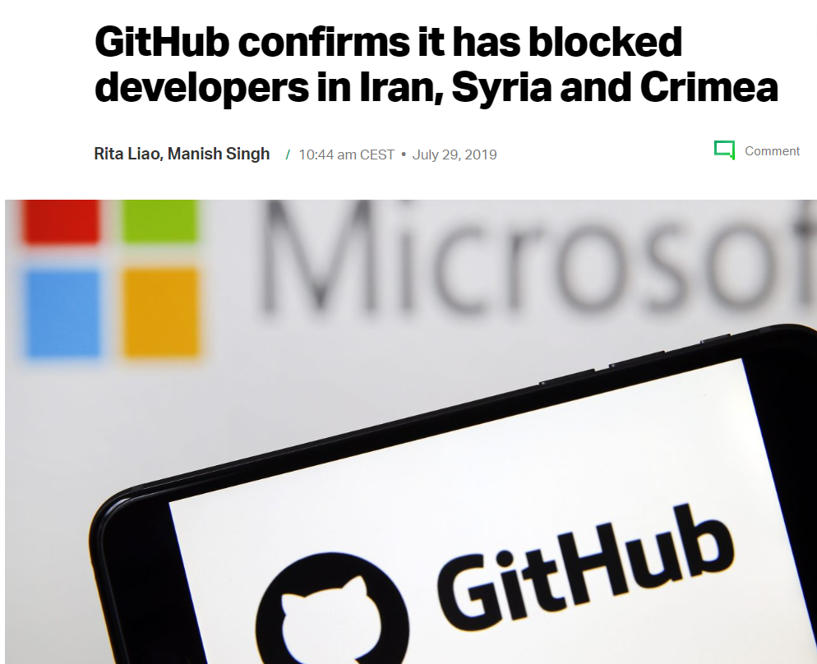
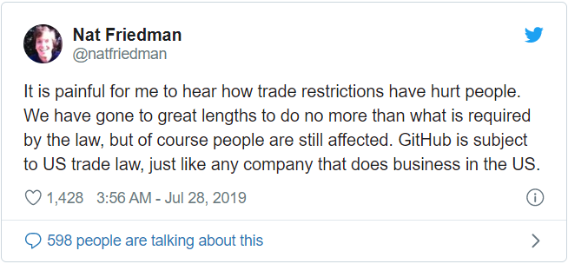
US Trade Law
July 2019
Restriction on creating new repository
No Access to previously created repositories
Ref. https://techcrunch.com/2019/07/29/github-ban-sanctioned-countries/

Slide 8
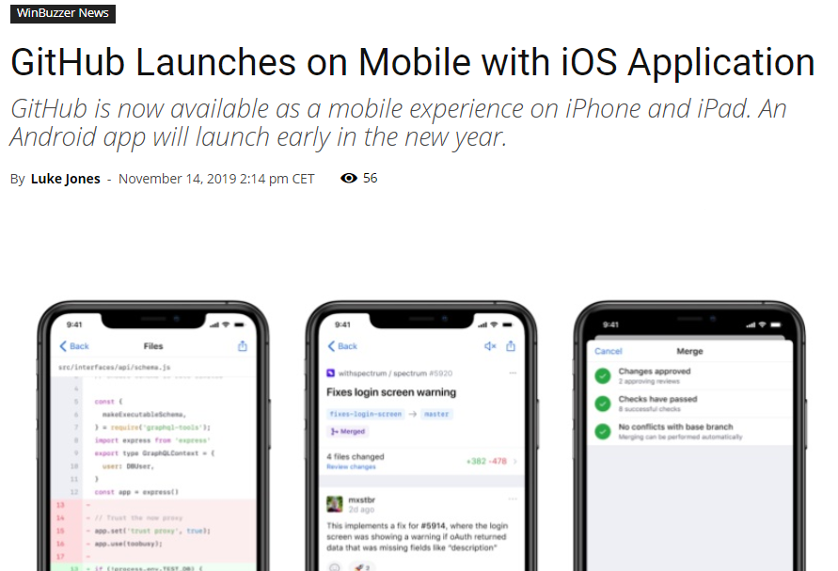
Fast forward
November 2019
GitHub Launches on Mobile with iOS Application
Only Available for Beta Testers
Ref https://winbuzzer.com/2019/11/14/github-launches-on-mobile-with-ios-application-xcxwbn/

Slide 9
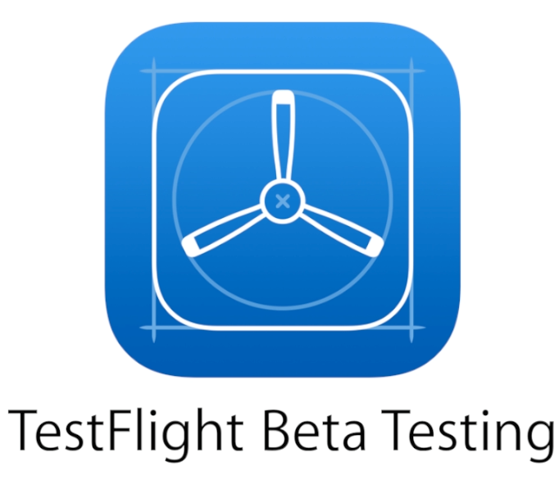
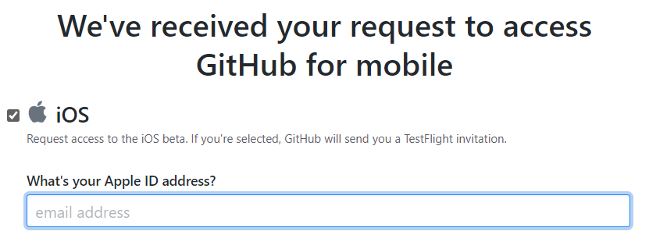
New Github app
Get it from Apple TestFlight
First Publicly Available Version - Build 45
Today – Build 81
Very Basic Features
Possible to see my blocked repository 🎉🎉🎉

Slide 10


Slide 11
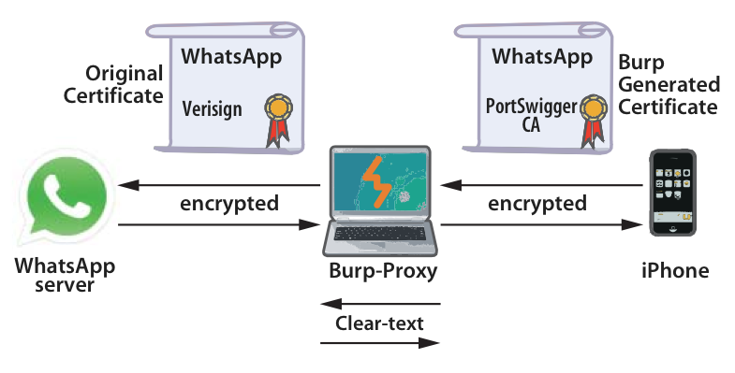
proxy
https://www.jorgealdana.pro/blog/seguridad/burp-proxy-aplicacion-de-seguridad-para-desarrolladores-de-android/

Slide 12
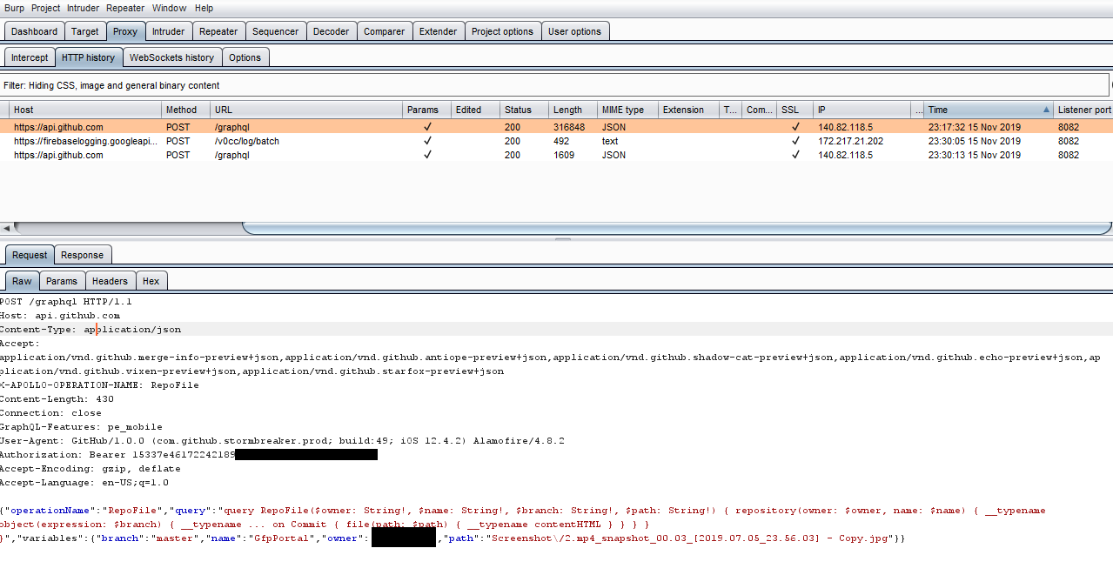
process

Slide 13

graphql
is a new API standard that provides a more efficient, powerful and flexible alternative to REST services.
It was developed and open-sourced by Facebook and is now maintained by a large community of companies and individuals from all over the world.
http://graphql.org/

Slide 14
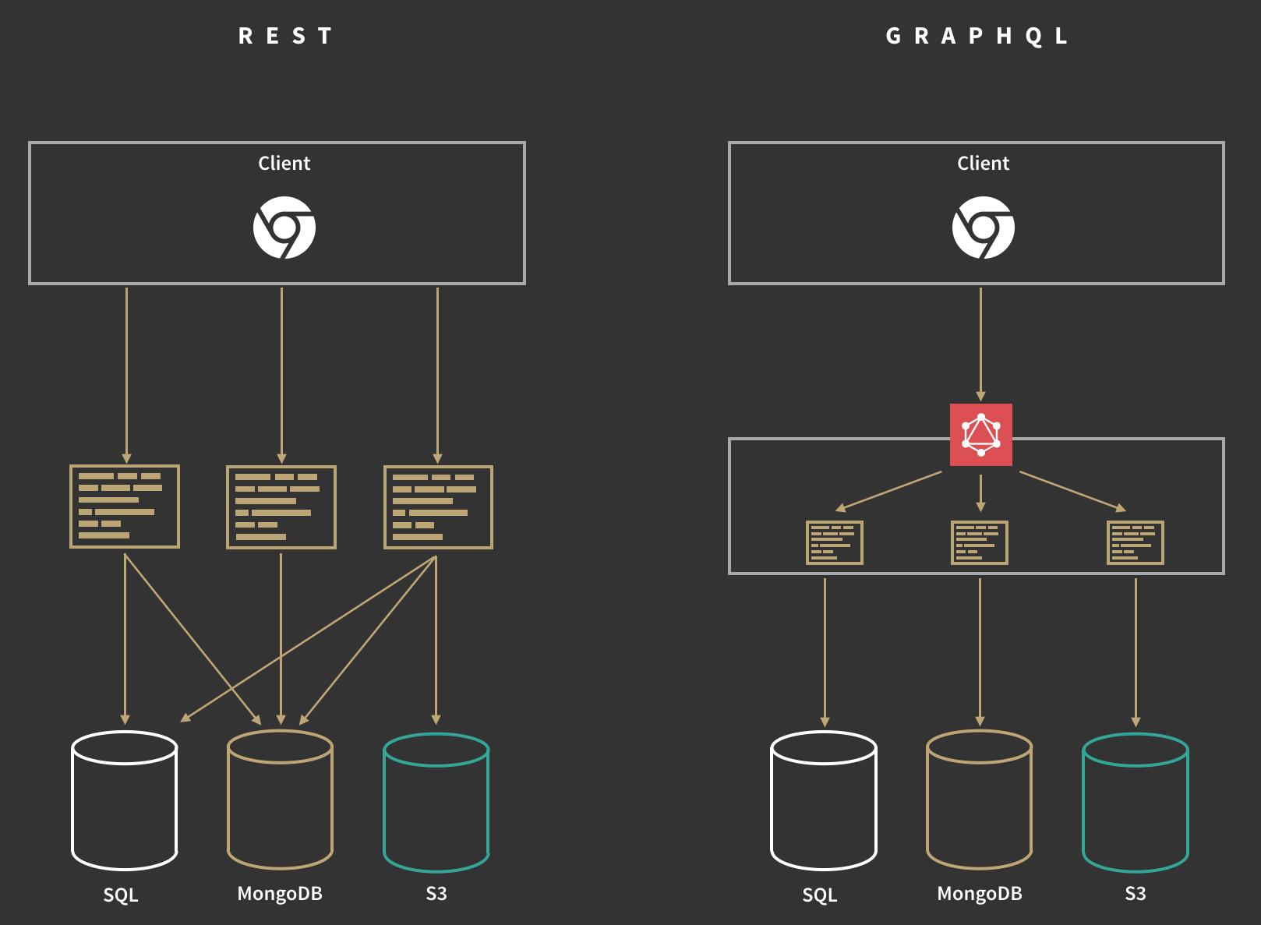
https://blog.apollographql.com/how-do-i-graphql-2fcabfc94a01

Slide 15
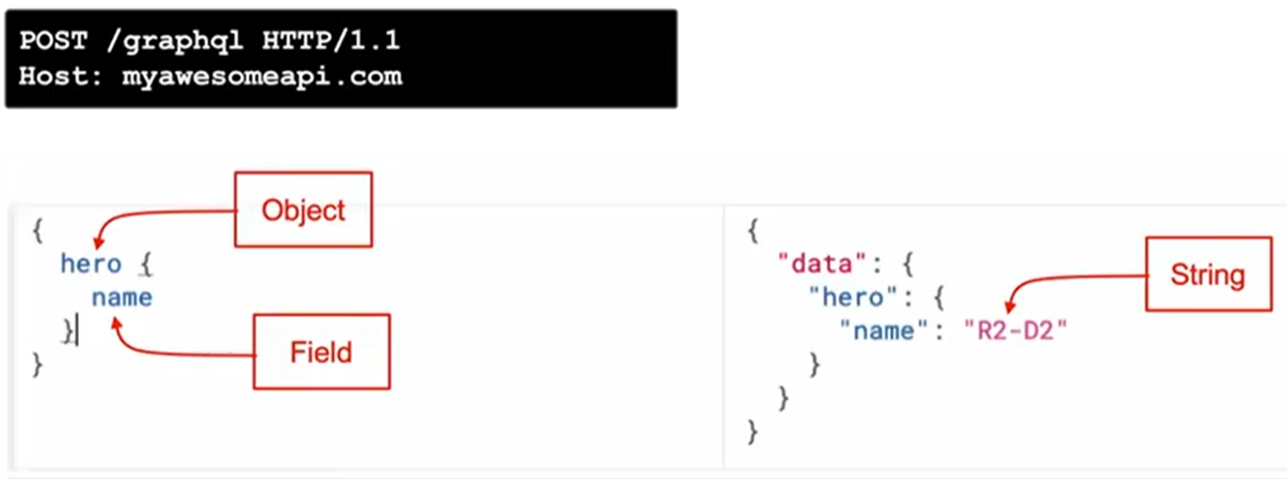
Graphql queries
https://graphql.org/learn/queries/

Slide 16
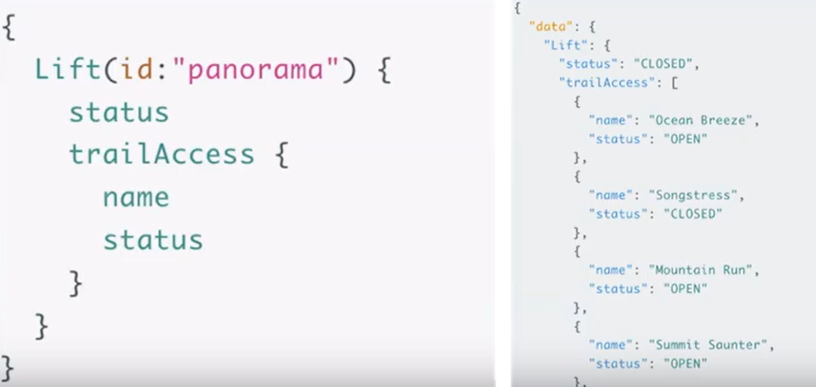
Graphql queries
https://graphql.org/learn/queries/

Slide 17
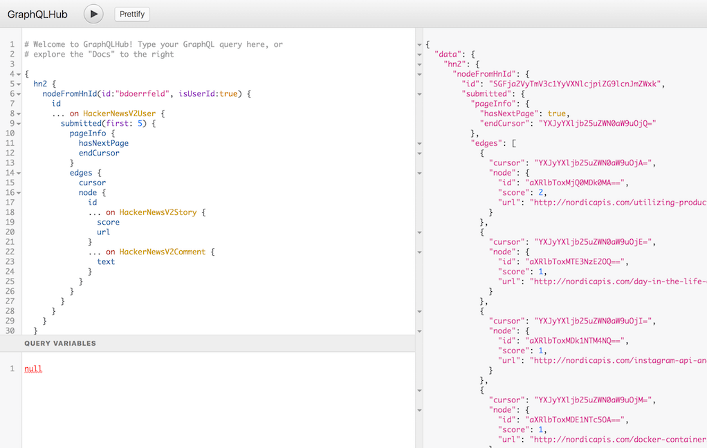
https://nordicapis.com/10-graphql-consoles-in-action/

Slide 18
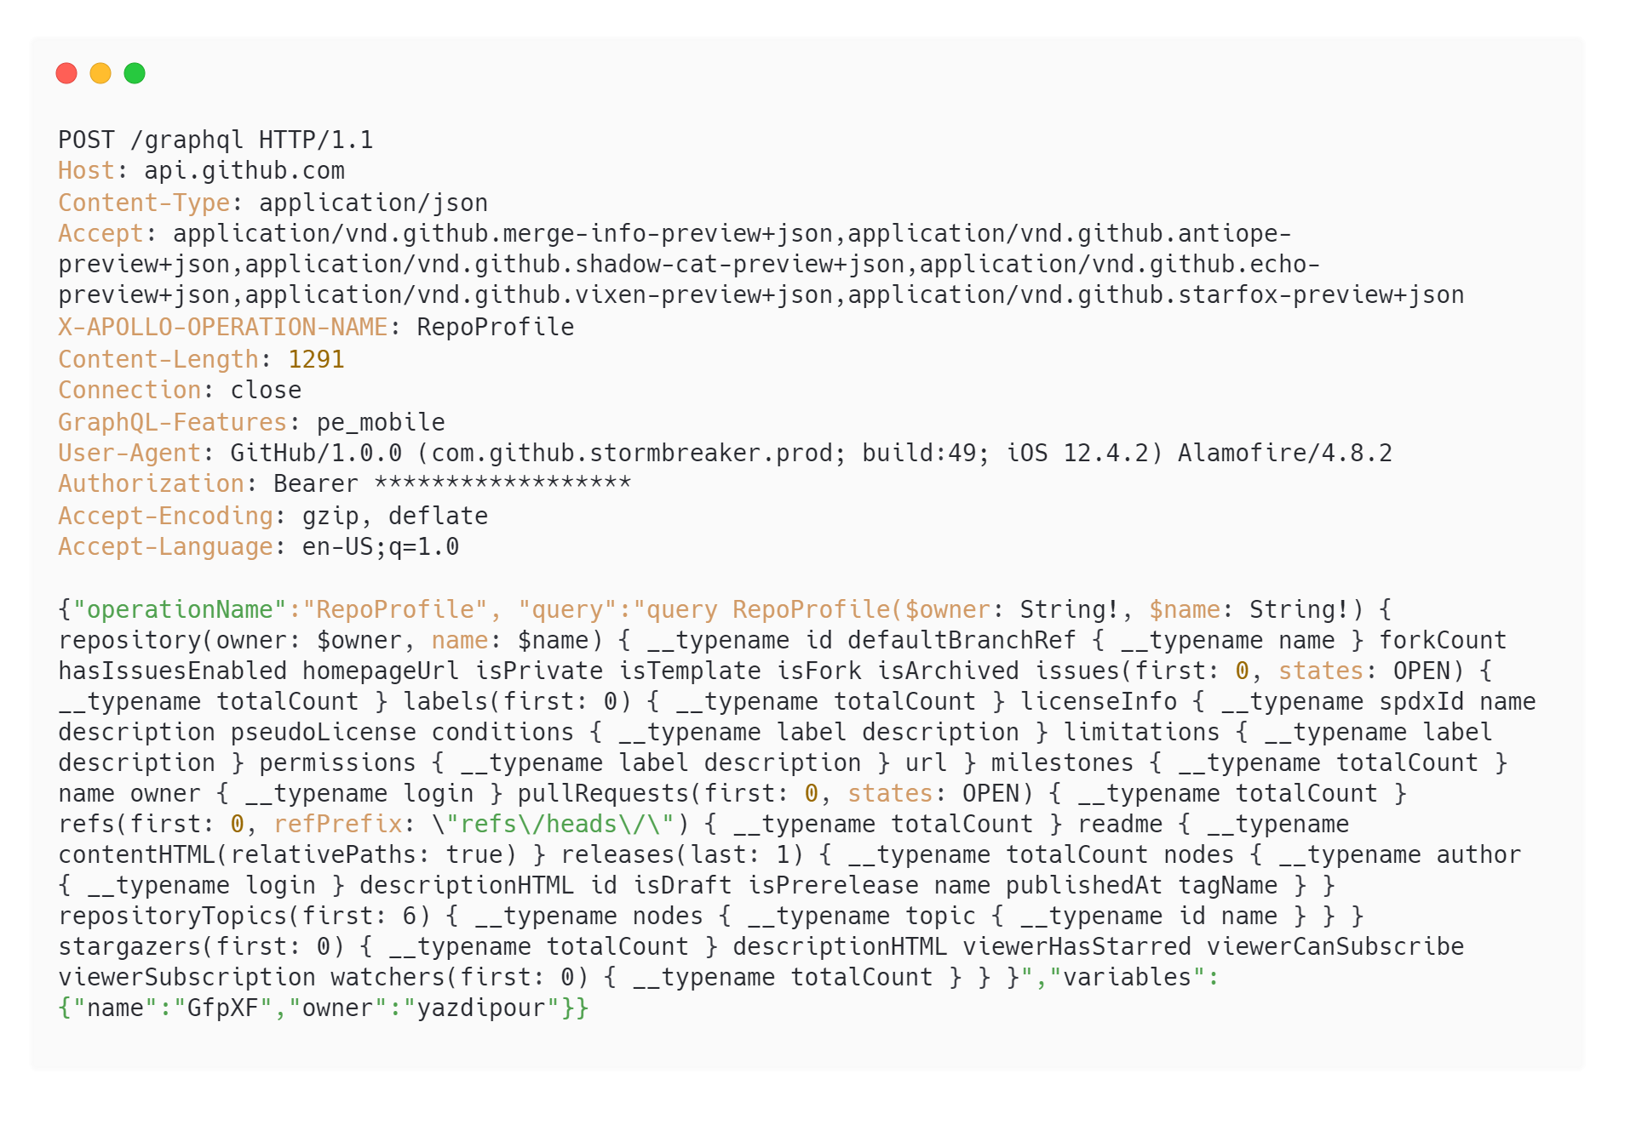
Analysis traffic – Repository

Slide 19
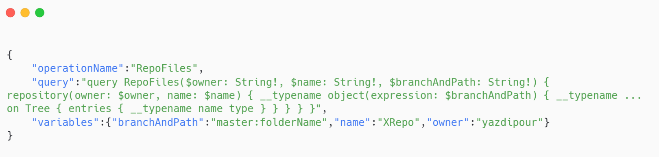
Analysis traffic – Directory

Slide 20
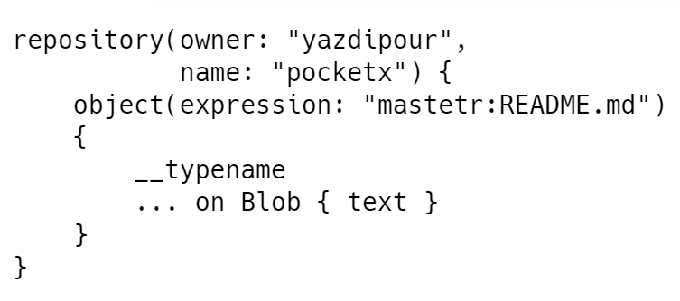
Analysis traffic – data

Slide 21
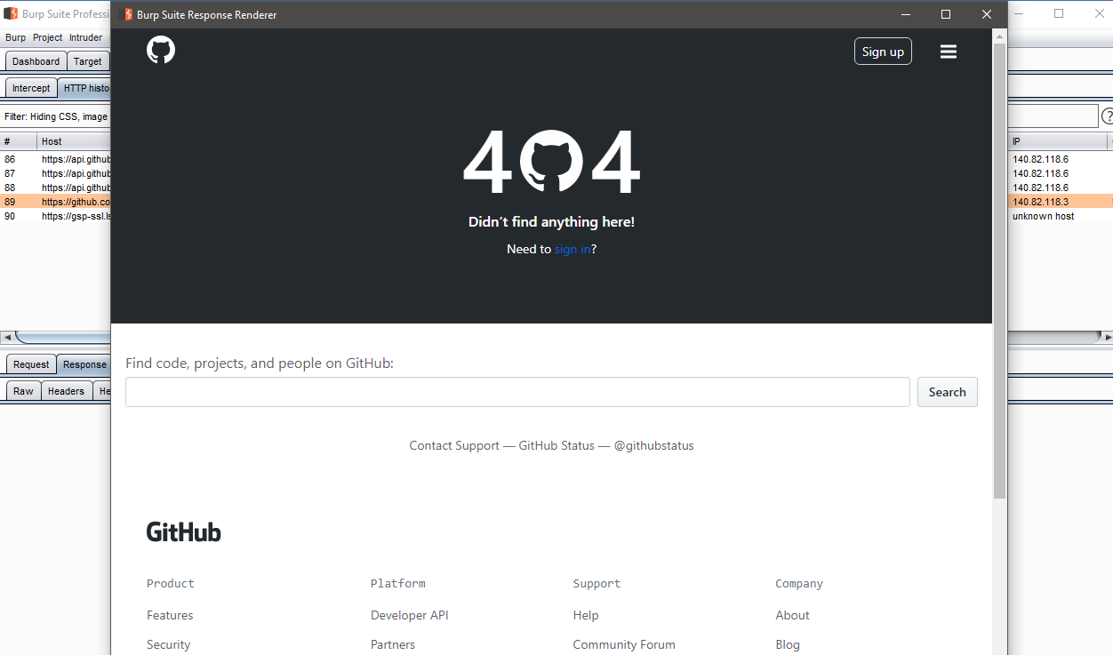
Analysis traffic – binary data

Slide 22
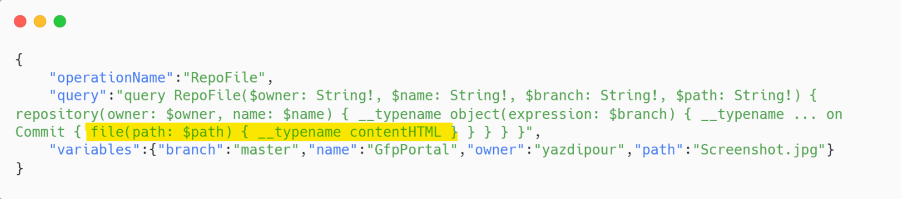
Analysis traffic – binary data
file() Method is not mentioned in Github GraphQL Documentation
Does not work with Developer Token!

Slide 23
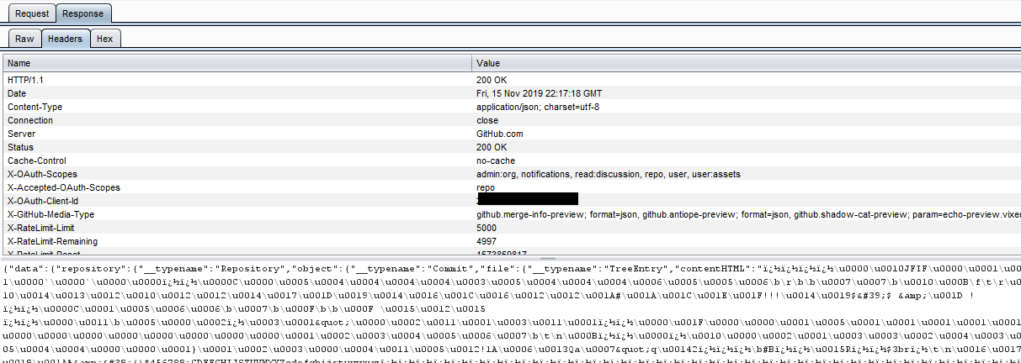
Analysis traffic – binary data

Slide 24
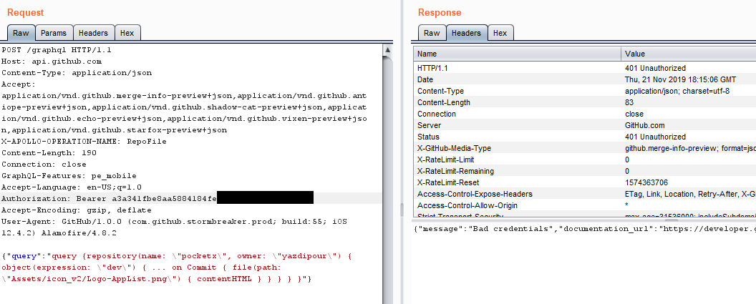
Can it be generalized? Make a tool out of it?!

Slide 25
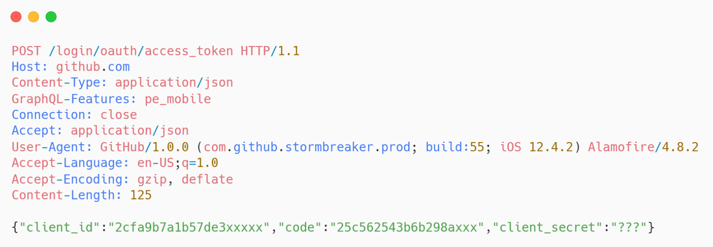
Fake Auth
We have the "client_id" and "code“ by sniffing authentication process.
Easily get the client_secret

Slide 26
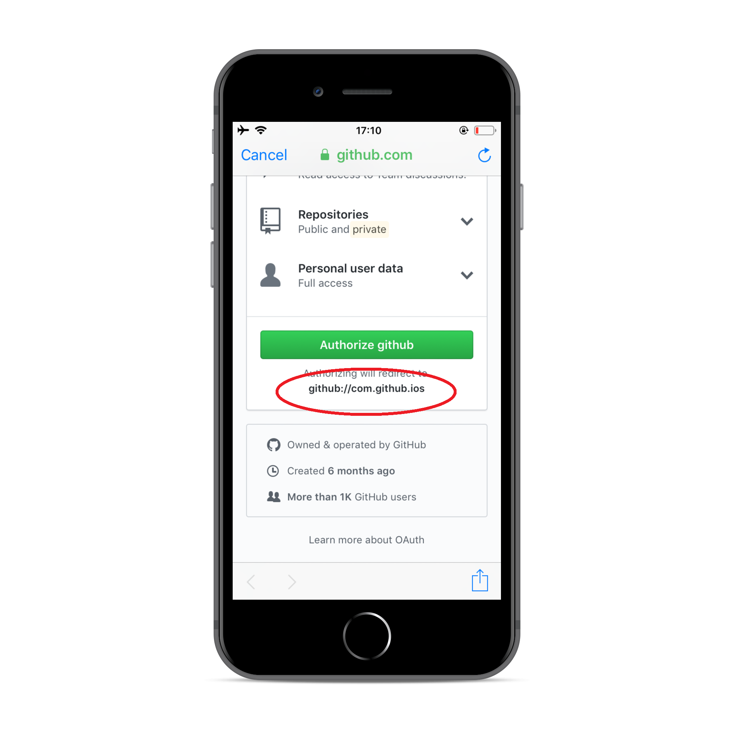
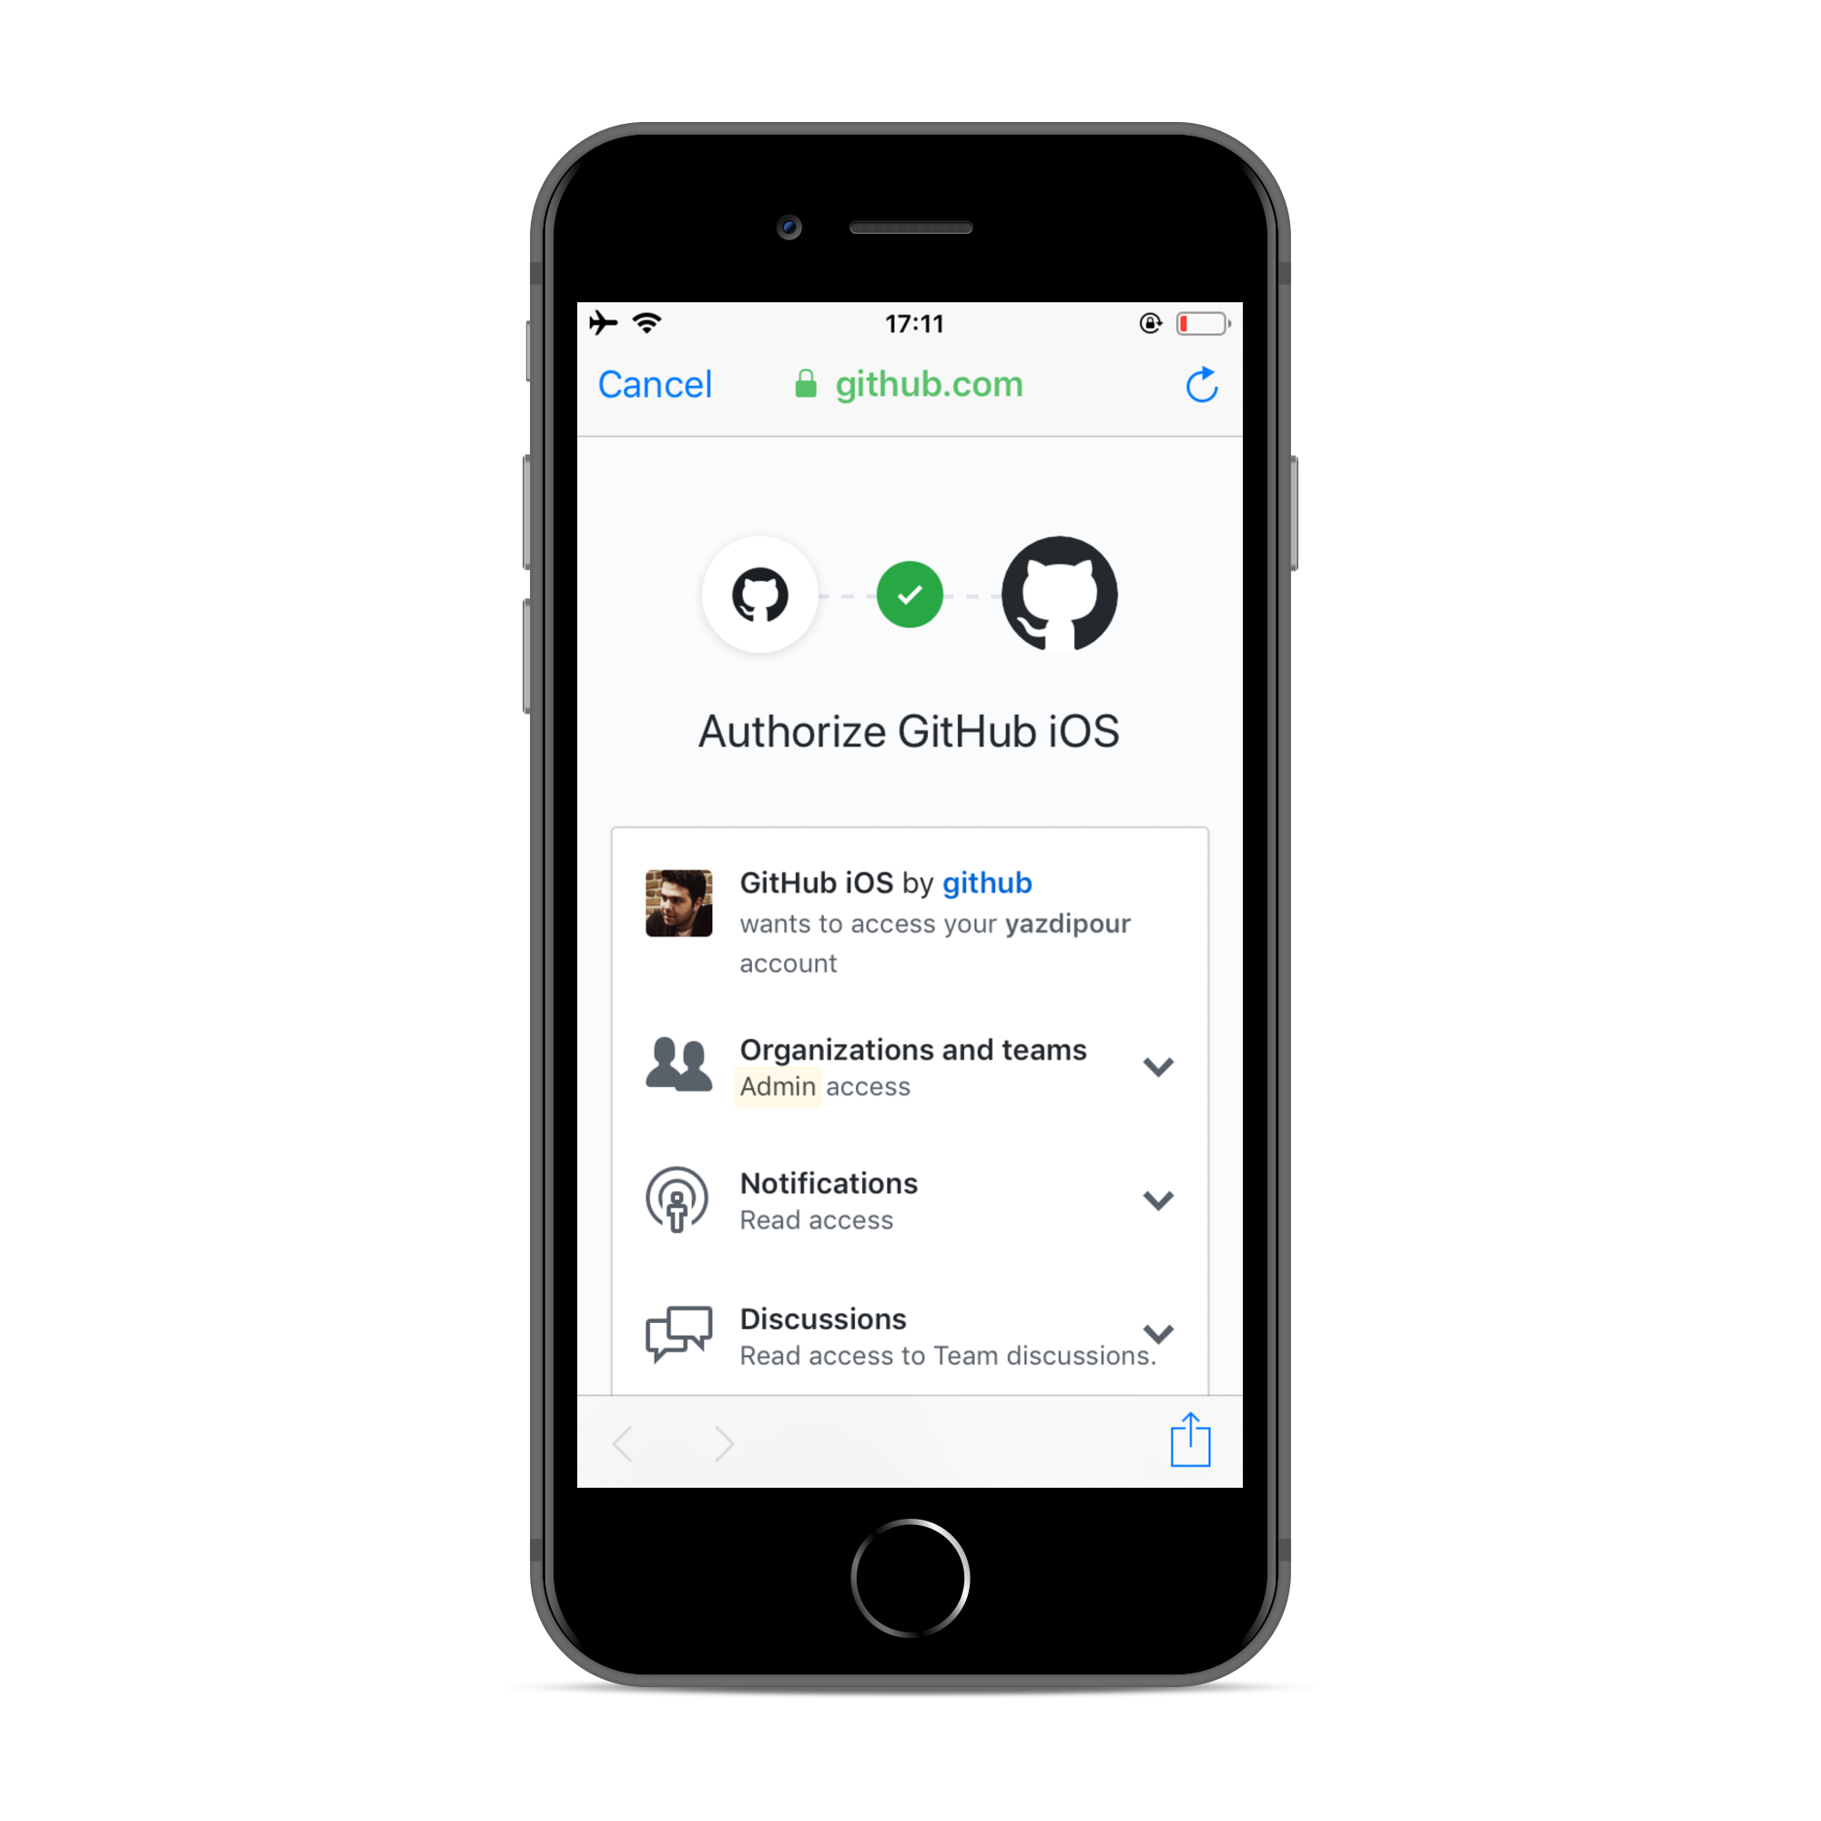
Fake Auth

Slide 27
Conclusion
Access Repository Information
Access Repository Directory
Access Repository Files
Reported to Github Security Team
Category: api.github.com
Severity: Low
Weakness: Improper Access Control CWE-284

Slide 28
Reference
Github Documentations
Burp-suite Documentations
Facebook GraphQl Documentations
Graphql Octokit Documentation
OWASP Security Handbook

Slide 29
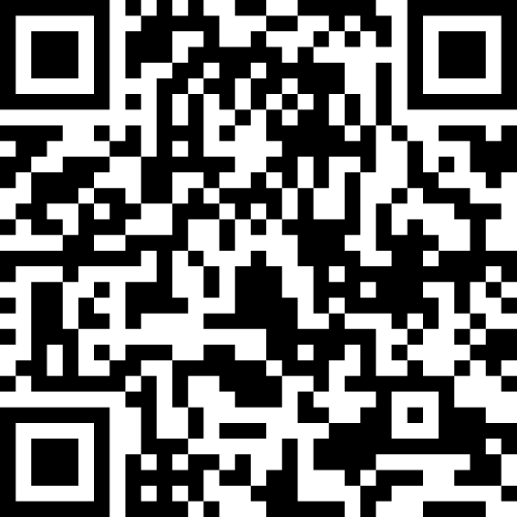

Thank You.
Shahriar Yazdipour
github.com/yazdipour/presentations

